Slide 1

External Tools for Power BI
<presenter>

Slide 2

DAX Studio Tabular Editor ALM Toolkit

Slide 3

DAX Studio

Slide 4
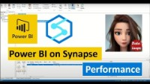
Performance Tuning

Slide 5
DAX Formatter

Slide 6
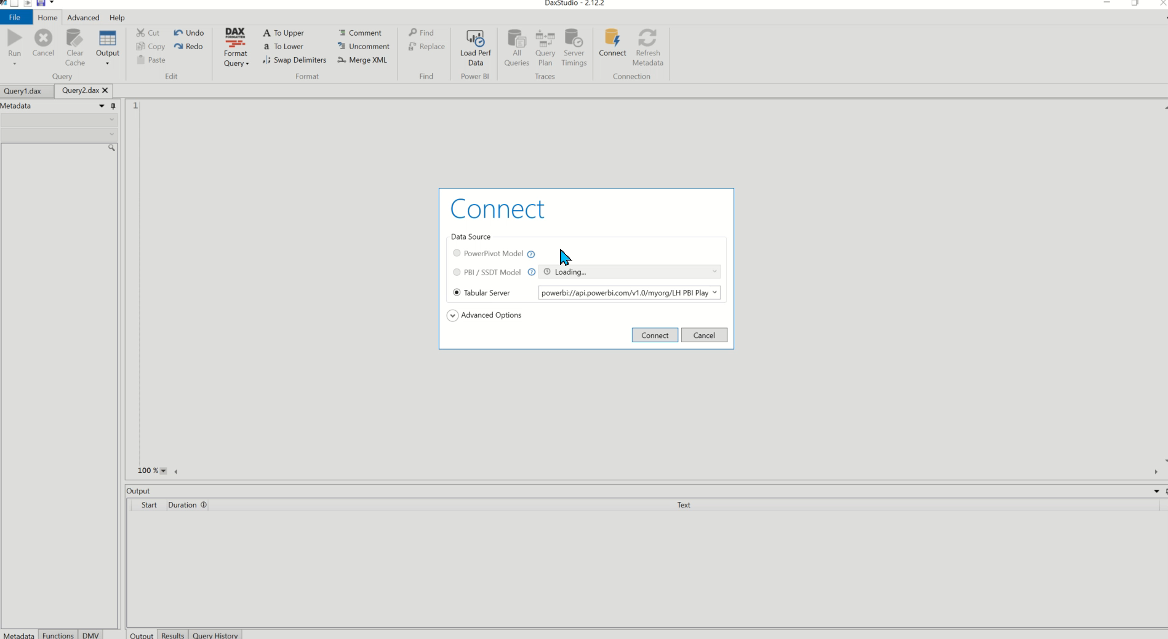
Dependencies

Slide 7
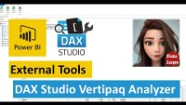
Vertipaq Analyzer

Slide 8
Tabular Editor

Slide 9
Best Practice Analyzer

Slide 10
Documentation

Slide 11
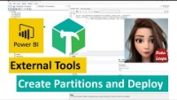
Partitions

Slide 12

Calculation Groups

Slide 13

Perspectives

Slide 14
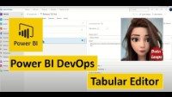
CICD

Slide 15
ALM Toolkit

Slide 16
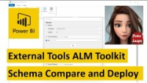
Schema Compare and Meta Data Only Deployment

